Slide 1
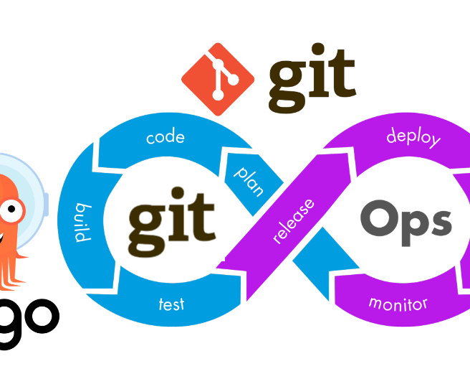
Gitops
Streamlining DevOps with Version Control

Slide 2
What is GitOps?
GitOps is a software development and operations methodology that leverages version control systems, primarily Git, to automate and manage the deployment, configuration, and infrastructure of applications and services. In GitOps, the desired state of the system is defined and stored in Git repositories, and automated processes continuously ensure that the actual system state matches this desired state. This approach enhances collaboration, traceability, and repeatability in software development and operations, making it well-suited for cloud-native and containerized environments, such as Kubernetes.
Key points of GitOps include:
Version Control as Source of Truth: GitOps relies on Git repositories as the authoritative source of configuration and application state. Everything from infrastructure code to application configurations is stored in version control.
Declarative Configuration: In GitOps, configurations are declared in a desired state format. These declarative configurations describe how the system should look, and automated processes ensure the actual state matches this declaration.
Automation: GitOps emphasizes automation for deployment and synchronization. Continuous Integration/Continuous Deployment (CI/CD) pipelines and Git-based triggers automate the deployment and maintenance of the system.
Infrastructure as Code (IaC): GitOps encourages the use of infrastructure as code principles. Infrastructure and application configurations are codified, allowing for reproducibility and scalability.
Immutable Infrastructure: Changes are made by replacing the entire infrastructure with a new version, ensuring that the environment remains consistent and predictable.

Slide 3
GITOPS Workflow
The GitOps workflow is a continuous and automated process for managing and deploying applications and infrastructure using Git repositories as the source of truth. Here is an overview of the typical steps in a GitOps workflow:
Version Control (Git Repository):
The desired state of the system, including infrastructure configurations, application code, and deployment manifests, is stored in a Git repository. This repository serves as the source of truth.
Commit and Pull Request:
Developers make changes to the configurations or application code and commit these changes to the Git repository.
To maintain quality and collaborate effectively, changes often go through a code review process using pull requests.
Continuous Integration (CI):
A CI system automatically builds and tests the changes from the Git repository.
If the CI process succeeds, it generates artifacts and reports for further deployment.
Continuous Deployment (CD):
An automated CD system monitors the Git repository for changes.
When a change is detected, it deploys the new desired state to the target environment (e.g., staging, production) based on the declarative configurations defined in the Git repository.
Validation and Synchronization:
After deploying the new desired state, the CD system continually validates and synchronizes the actual state of the system with the desired state stored in Git.
If there are discrepancies, the CD system takes corrective actions to bring the system back to the desired state.
Rollbacks and Roll-forwards:
If issues are detected in the actual state (e.g., application failures or infrastructure problems), the CD system can perform automated rollbacks to the last known good state.
It can also facilitate roll-forwards to apply fixes or updates when issues are detected, maintaining a continuous state of desired configurations.
Monitoring and Alerts:
Continuous monitoring and alerting systems are set up to provide real-time insights into the health and performance of the system.
Alerts are generated if there are discrepancies between the desired and actual states, or if issues are detected during deployments.
Auditability and Compliance:
Because all changes are tracked in Git, GitOps provides strong auditability. It's easy to trace who made what changes, when, and why, which is crucial for compliance and auditing requirements.
Scaling and Collaboration:
GitOps is highly scalable and supports collaboration between development and operations teams, as they can work on configurations and code within the same Git repository.
Secrets Management and Access Control:
GitOps can incorporate secure secrets management and access control for sensitive information, ensuring that security is an integral part of the workflow.

Slide 4
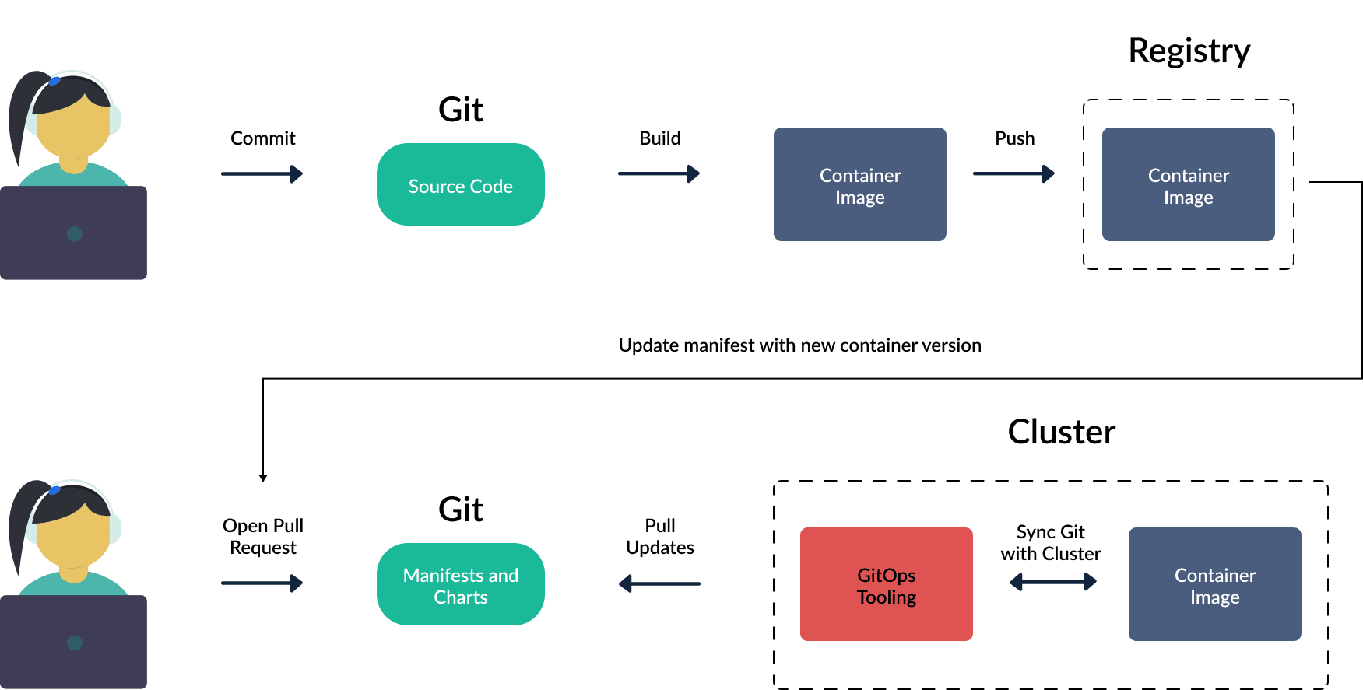

Slide 5
Advantages
Version Control as Source of Truth: Using Git as the source of truth ensures that all configurations, infrastructure changes, and application code are tracked and versioned, making it easy to review, roll back, or audit changes.
Automated Deployments: GitOps automates the deployment process, reducing manual intervention, human errors, and deployment-related issues. This leads to faster and more reliable deployments.
Declarative Configuration: GitOps uses declarative configurations, specifying the desired state of the system. This approach is more predictable and allows for easy rollbacks and disaster recovery.
Collaboration and Transparency: Development and operations teams can collaborate more effectively as everything is stored in a central Git repository. Changes are visible to the entire team, promoting transparency.
Auditability and Compliance: The versioned nature of GitOps enables easy auditability. Organizations can easily trace and review changes, making it well-suited for compliance and regulatory requirements.
Continuous Monitoring and Validation: Automated systems continuously monitor the system's actual state, ensuring it matches the desired state. This proactive approach helps identify and rectify issues faster.
Immutable Infrastructure: GitOps encourages the use of immutable infrastructure, where changes are made by replacing existing infrastructure with a new version. This approach enhances system reliability and repeatability.
Scalability: GitOps is scalable and adaptable to various infrastructure and application types, making it a suitable approach for modern, dynamic, and cloud-native environments, including Kubernetes.
Security Integration: GitOps can incorporate secure secrets management and access control, making it an integral part of a secure DevOps workflow.
Resilience: In the event of system failures or issues, GitOps provides the capability for rapid rollbacks to a known good state, ensuring quick recovery.
Easy Rollbacks and Roll-forwards: GitOps makes it straightforward to perform rollbacks to a stable state or roll-forwards to apply fixes and updates when issues are detected.
Time and Cost Savings: By automating deployments and providing a consistent approach, GitOps can save time and reduce operational costs, making it more efficient than traditional manual approaches.
Growth in Popularity: GitOps is gaining traction in the DevOps community and is supported by a growing ecosystem of tools and practices.

Slide 6
GitOps in Action
Scenario: Kubernetes Cluster Deployment
Imagine an organization that utilizes Kubernetes for managing its containerized applications in a microservices architecture. They've adopted GitOps to streamline their deployment processes.
1. Git Repository Setup:
The organization creates a Git repository to serve as the central source of truth for their Kubernetes cluster configurations. This repository includes YAML files for Kubernetes manifests, Helm charts, and any other required configurations.
2. Declarative Configurations:
Developers and operations teams work together to define the desired state of their Kubernetes cluster in this Git repository. This includes deployment specifications, service configurations, secrets, and environment variables, all declared in a declarative format.
3. CI/CD Integration:
The organization sets up a CI/CD pipeline, which monitors the Git repository for changes. When new code or configuration changes are committed to the repository, the CI/CD system automatically triggers the pipeline.
4. Automated Testing:
In the CI/CD pipeline, automated testing procedures are executed to validate the configurations and application code. This ensures that only working and validated code is promoted to the cluster.
5. Continuous Deployment:
Upon successful testing, the CI/CD system deploys the changes to the Kubernetes cluster. The CD tool (e.g., ArgoCD or Flux) continuously monitors the Git repository and synchronizes the actual cluster state with the desired state declared in Git.
6. Monitoring and Alerts:
The organization has set up monitoring and alerting systems for the Kubernetes cluster. Any discrepancies between the actual and desired states trigger alerts. For example, if a pod restarts repeatedly, an alert is generated.
7. Rollbacks and Roll-forwards:
If an issue is detected in the cluster, the CD system can automatically trigger a rollback to a previous known good state. Conversely, it can perform roll-forwards to apply fixes and updates, keeping the system in the desired state.
8. Collaboration and Security:
Developers and operations teams collaborate within the Git repository, making changes, suggesting improvements, and discussing issues in the Git pull request (PR) process.
Secrets and sensitive information are securely managed within the Git repository, ensuring that security is an integral part of the GitOps workflow.
9. Scalability:
As the organization scales, GitOps easily accommodates new microservices, application versions, and infrastructure changes. The same GitOps approach is applied consistently to all new components.
10. Compliance and Auditability:
The version-controlled nature of the Git repository makes it easy for the organization to demonstrate compliance with internal and external standards. Auditors can review the Git history to see who made changes, what changes were made, and when they occurred.
This real-world example demonstrates how GitOps can be applied to manage a Kubernetes cluster effectively, offering benefits like automation, reliability, collaboration, and security while maintaining a declarative, version-controlled approach.

Slide 7
Thank You

